Slide 1
The laboratory investigation of infection

Slide 2
Outline of the Chapter
History and examination
Differential diagnosis
Clinical request and sample collection
Clinical specimen
Non- culture techniques
Culture techniques
Susceptibility
Diagnosis
Treatment

Slide 3
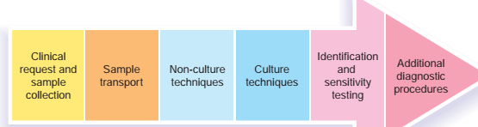
Diagnostic Medical microbiology
Recognizing microorganism associated with human disease.
Concerned with the etiologic diagnosis of infection
Detect infections caused by:
Bacteria
Viruses
Fungi
Fig. 1 Diagnostic template

Slide 4
Clinical request form
A detailed request form that accompanies a clinical sample is pivotal in ensuring the appropriate diagnostic procedures
Information should include:
Patient details
Clinical diagnosis
Onset of symptoms
Sample type
Time of collection
Treatment history
Concurrent antimicrobial therapy and
Any health and safety issues.

Slide 5
Sample collection
Laboratory test results depend largely on,
Quality of specimen
Timing and care with which it is collected
Sample through an area containig normal flora
Prior to commencement of antimicrobs
Transported, and
Technical proficiency and
Experience of laboratory personnel.

Slide 6
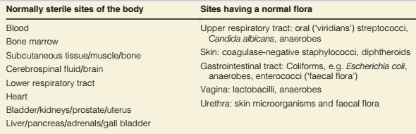
Table: Sterile and non-sterile sites of the human body

Slide 7
Transport of clinical samples
Rapid transport of sample to Lab is necessary due to
presence fastidous microorganism; N. gonorrhoeae & H. influenzae, die during transit
overgrowth by contaminating normal flora obscuring the pathogen
Use of transport media
Short delay use refrigeration (4°C)
For long term storage freezing at 70 °C

Slide 8
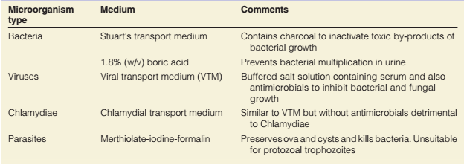
Table: Common transport media

Slide 9
Clinical Specimen
Urinary tract infection (UTI) – Midstream urine
Wound – Pus or swab
Meningitis – CSF & blood
Pyrexia of unknown origin (PUO) – Blood for culture + serology
Pneumonia – Sputum, lavage, serology

Slide 10
1. Non-culture techniques
Non-culture techniques are of importance:
Microorganism cannot be readily cultured in vitro;
Microorganism is slow-growing;
Rapid laboratory diagnosis significantly influences clinical management of the patient
Direct microscopy
Immunological methods
Serology and
Nucleic acid amplification techniques (NAAT).
Common non-culture techniques

Slide 11
1.1. MICROSCOPY
Light – Direct/unstained wet mount (stool – parasites) – Stained preparation;
Gram (CSF – bacteria)
Ziehl-Neelson (sputum – TB)
Giemsa (blood – malaria)
Immunofluorescence – Respiratory syncytial virus (RSV) diagnosis
Electron microscopy (EM) – Virus detection and identification

Slide 12
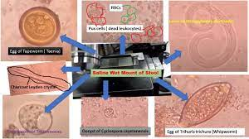
Unstained wet mounts
Identify the presence of motile T. vaginalis in fresh high vaginal specimens and
Cysts/ova/larvae of gastrointestinal parasites in faecal samples
Value in diagnosis of some fungal infections

Slide 13
Stained preparations
1. Gram stain
Most widely used stain
Classifies bacteria into
Gram-positive cocci/bacilli and
Gram-negative cocci/bacilli
Establishes presence of inflammatory cells
Also facilitates diagnosis of many fungal infections

Slide 14
Gram stain method
Spread specimen thinly on glass microscope slide and heat fix;
Stain with crystal violet (purple);
Add Lugols iodine (this fixes dye in GPB only);
Decolourise with acetone or alcohol (only GNB are decolourised; GP remain purple);
Counter stain; safranin/carbolfuchsin (stains GNB Pink; GPB remain purple).

Slide 15
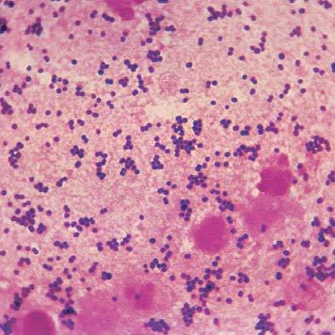
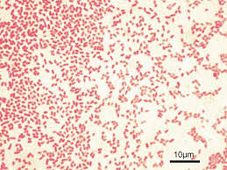
Gram positive bacteria
Gram negative bacteria
Notes:
Gram positive bacteria

Slide 16
Ziehl-Neelson (ZN) stain
ZN stains can be performed on many clinical samples
Principally to identify mycobacterial infection (MTB)
Methods
Spread specimen thinly on glass microscope slide and heat fix;
Stain with HOT Carbol–fuchsin dye (all bacteria are stained pink);
Decolourise with 3% acid-alcohol (mycobacteria retain dye and are therefore ‘acid fast’);
Counter stain with Methylene blue or malachite green to reveal non-mycobacterial microorganisms.
Mycobacteria are stained pink, non-mycobacteria are blue or green

Slide 17
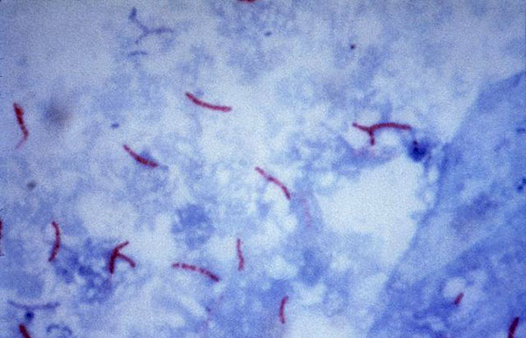
Acid fast bacilli
Notes:
Acid fast bacill

Slide 18
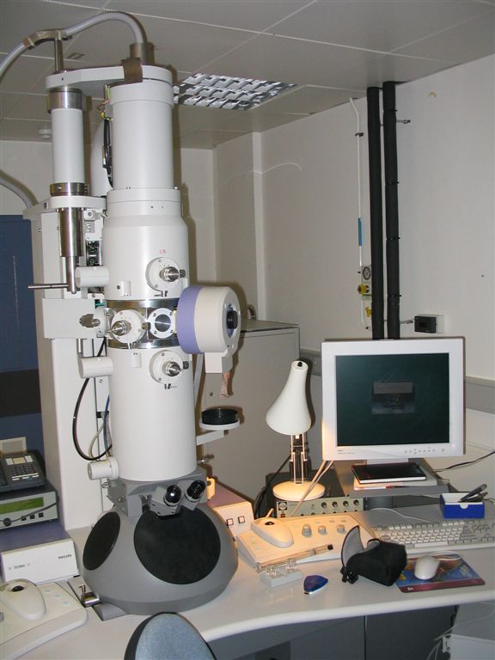
Electron microscopy (EM)
EM is used to visualize and rapidly identify viruses in some clinical samples
e.g. rotavirus/norovirus/ in faecal samples or herpes simplex and varicella zoster in blister fluids
Electron Microscopy

Slide 19
1. 2. Immunological methods
Used for detection of bacterial antigen
Serological detection of antibody/antigen in the patient’s serum.
Antibody-antigen reaction must be made visible and can be achieved by various techniques
C. neoformans capsular Ag in CSF samples
S. pneumoniae Ag in urine samples using specific antibody
Notes:
CSF-Cerbro spinal fluid; Ag-Antigen

Slide 20
1.3. SEROLOGICAL TECHNIQUES
Agglutination
Precipitation
Complement fixation
Virus neutralization
Enyzme linked immunosorbent assay (ELISA)
Radioimmunoassay (RIA)
Immunofluorescence

Slide 21
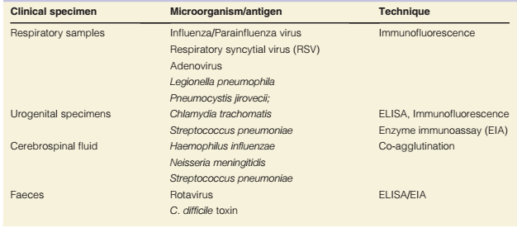
Table: Direct detection of Microbial antigens in clinical samples

Slide 22
1.4. Molecular techniques
NAAT: Molecular biology techniques for detection and amplification of microbial NA in specimens
Useful for mos. that are difficult or slow to culture
Greater sensitivity
DNA hybridization – Nucleic acid amplification testing – Polymerase chain reaction (PCR) – Ligase chain reaction (LCR) – Automated DNA amplification – Real time PCR
Process: Denaturing Primers (94°C) –annealing (55°C) – Extension (72°C)
Notes:
NA, Nucleic acid

Slide 23
B. Culture techniques
Most medically important bacteria and fungi can be cultured
on laboratory agar or in enrichment broths.
Definitive method of confirming a diagnosis of infection.
Various types of microbiological media exist:
Basic agar
Enriched agar
Selective agar
Differential agar
Enrichment broth
Selective enrichment broth
Notes:
recovers clinically important bacteria including fastidious mos. recovers the majority of medically important bacteria (nutrient agar)

Slide 24
Cont.
Simple media: nutrient broth/nutrient agar: peptone/meat extract
Enriched media: Blood agar or Chocolate agar: additional nutrients
Selective media: growth of some bacteria/suppressing other:
MSA: NaCl-recovery of staphylococci
MAC: bile salts and allows the growth of bile-tolerant bacteria only
antibiotics
Indicator media/differential: sugar fermentation reactions
production of acid and the subsequent color change of a pH indicator (e.g. MAC and CLED)
Notes:
MSA; Mannitol salt agar; MAC; MacConkey agar; CLED; Cystine lactose electrolyte deficient agar

Slide 25
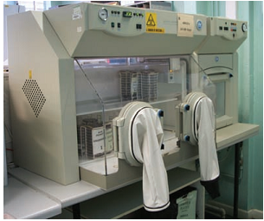
Atmosphere
Following inoculation, microbiological media are incubated under specific atmospheric conditions to allow growth of mos.
– Aerobic – CO2 – Anaerobic – Microaerophilic
Cell culture – Virus – Chlamydia
Fig. Anaerobic cabinet used for growing anaerobic bacteria

Slide 26
Bacterial Identification
To ensure correct and appropriate Rx of infection,
It is essential to accurately identify pathogens recovered from samples.
Identification techniques include:
Growth characteristics, e.g. strictly aerobic/anaerobic, facultative anaerobe; Speed of growth;
Colonial characteristics, e.g. size, shape, haemolysis, odour;
Microscopical appearance, e.g. GP/ GN; presence of hyphae/spores; bacillus/ coccus;
Antigenic characteristics, e.g. group specific carbohydrates (Lancefield grouping of b-haemolytic streptococci), presence of clumping factor/
Notes:
GP; Gram positive; GN; Gram-negative

Slide 27
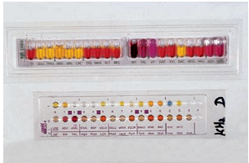
Cont.
Protein A (S. aureus), somatic/flagella Ags (Salmonella spp.);
Biochemical properties, e.g. fermentation of sugars, enzyme production;
Specific growth factor requirement, e.g. X and V (H. influenzae);
Gene probes, e.g. identify bacterial DNA/RNA, e.g. identification of mycobacteria;
Toxin production, e.g. Nagler test for Clostridium perfringens, ELISA for C. difficile toxins.
Fig. Commercial biochemical-based identification system (API)

Slide 28
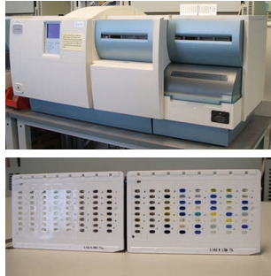
Antibiotic Susceptibility Testing (AST)
Microorganisms of clinical significance are investigated for antibiotic susceptibility.
Various AST methods are used in the laboratory:
Disc diffusion
Minimum inhibitory/bactericidal concentrations (MIC/MBC)
Agar dilution assay
VITEK R2 (bioMerieux): identification and susceptibility
Vitek ©2 machine and cards used for automated identification and AST

Slide 29
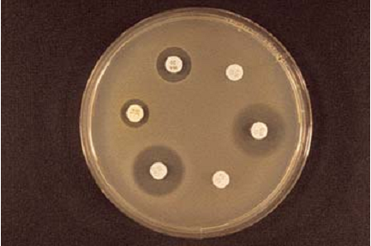
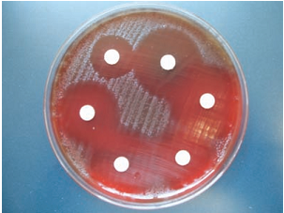
Susceptibility
Disk test,” is used to test the resistance of a bacterial culture to various anti-infective agents. The method provides a basis for classification of a bacterial strain as “susceptible,” “resistant,” or “intermediate” according to the dimension of the inhibition zone.
MHA-AST by disc diffusion
Fig. Antibiotic sensitivities of S. pyogenes by disc diffusion
Notes:
MHA-Mueller-Hinton agar

Slide 30
Typing
Typing is necessary in outbreak situations identify there relatedness of strain include:
Phage
Serology
Bacteriocin
Endonuclease digestion
Multilocus sequence typing
Whole genome sequence

